Slide 1
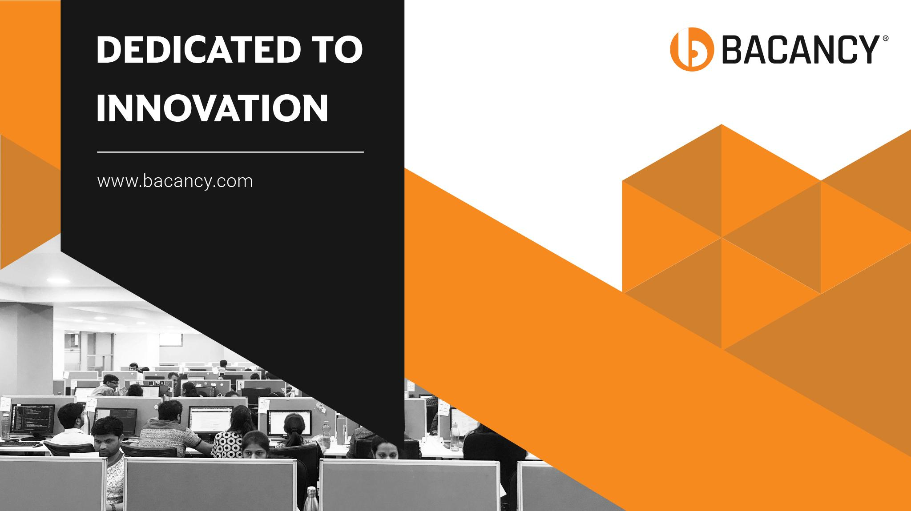

Slide 2

Customer Satisfaction
Is Our Highest Priority

Slide 3
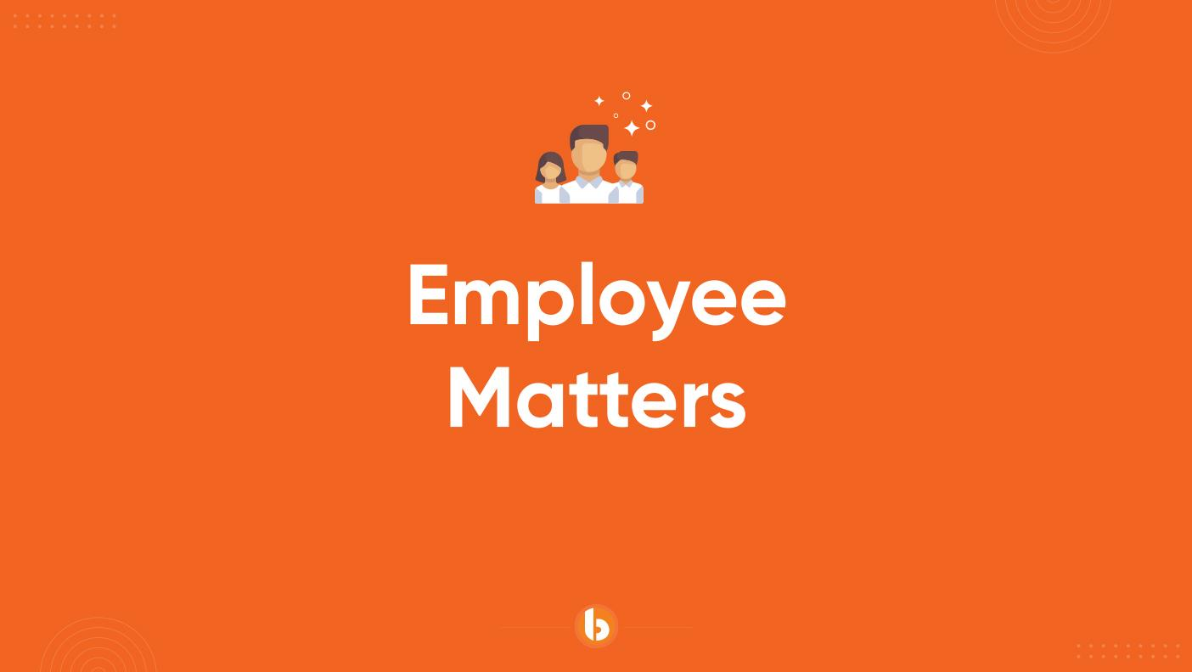

Slide 4
In this session
Achieved
What we are learning in this session
Advanced Inheritance and Polymorphism
SOLID principles
www.bacancytechnology.com

Slide 5
Let’s Start

Slide 6
Advanced Inheritance & Polymorphism
Achieved
New Keyword : The new keyword is used to indicate that a method or property in a derived class is intended to hide, rather than override, a method or property in the base class.
It's important to note that the new keyword can be used to hide any method or property, regardless of whether it's virtual or not.
The base class method can still be accessed using a base class reference.
Usage:
When you don’t want to override but just define a new implementation of a method in the derived class.
When both versions of the method should be accessible based on the reference type.
www.bacancytechnology.com

Slide 7
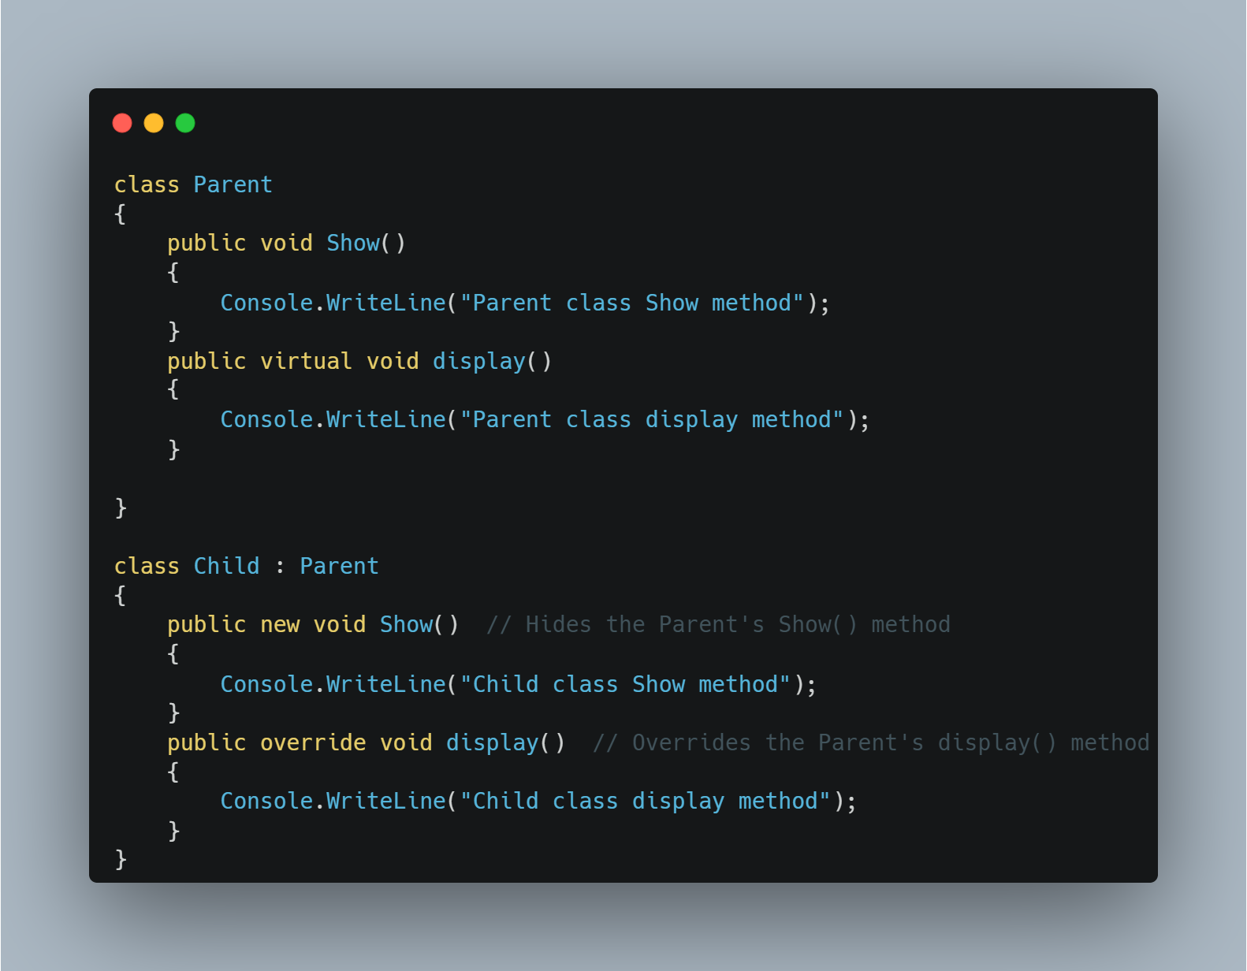
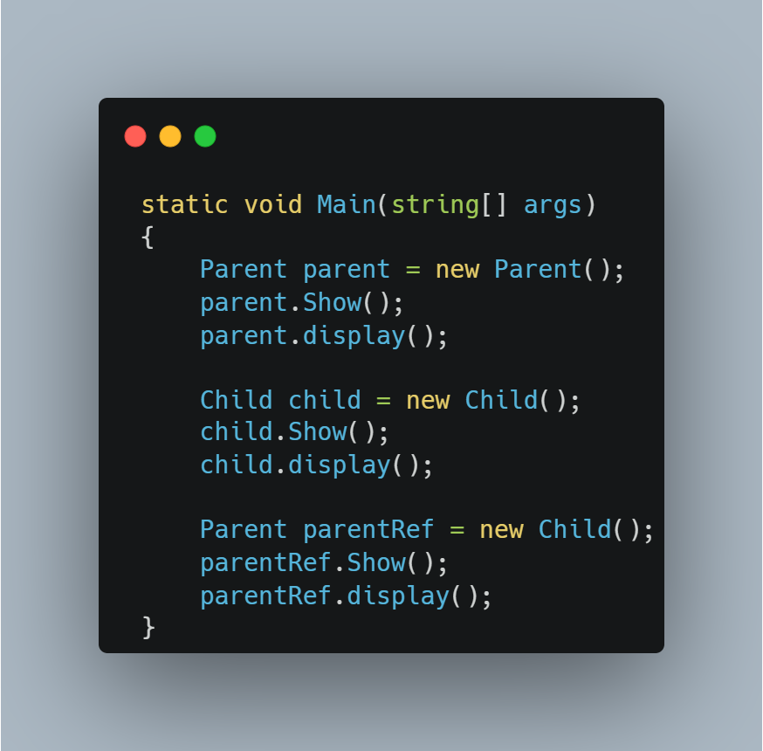
Advanced Inheritance & Polymorphism
Achieved
www.bacancytechnology.com

Slide 8
Difference between Method Overriding and Method Hiding
Achieved
Method Overriding | Method Hiding (new keyword)
Runtime binding (based on object type) | Compile-time binding (based on reference type)
Derived class method is called even with base class reference (polymorphism) | Base class method is called when using base class reference
If many implementations are of the same kind and use common behavior, then it is superior to use abstract class. | If many implementations only share methods, then it is superior to use Interface.
Used when a derived class wants to modify base class behavior dynamically | Used when a derived class wants to define a completely new independent method
When the parent class reference variable points to the child class, then the method in the child class is invoked while calling. | When the parent class reference variable points to the child class, then the hidden method in the parent class is invoked while calling.
www.bacancytechnology.com

Slide 9
SOLID Principles
Achieved
SOLID is a set of five principles in object-oriented programming (OOP) that help developers write clean, scalable, and maintainable code.
SOLID Design Principles represent five Design Principles used to make software designs more understandable, flexible, and maintainable. The Five SOLID Design Principles are as follows: 1. SRP – Single Responsibility Principle 2. OSP – Open – Closed Principle 3. LSP – Liskov Substitution Principle 4. ISP – Interface Segregation Principle 5. DIP – Dependency Inversion Principle
Applying the SOLID principles in our Application Development can make our application code more modular, easier to understand, and less error-prone when changes are made.
www.bacancytechnology.com

Slide 10
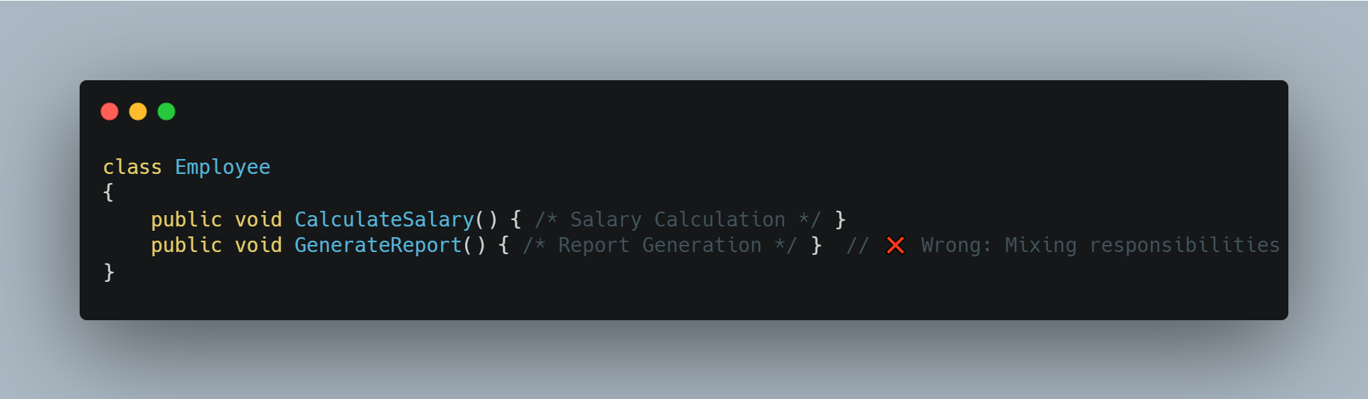
Single Responsibility Principle
Achieved
The SRP states that a class should have only one reason to change, meaning it should have only one responsibility. This promotes modularization and makes the code easier to understand and maintain.
Problem: The class is responsible for both salary calculation and report generation, which are unrelated.
www.bacancytechnology.com

Slide 11
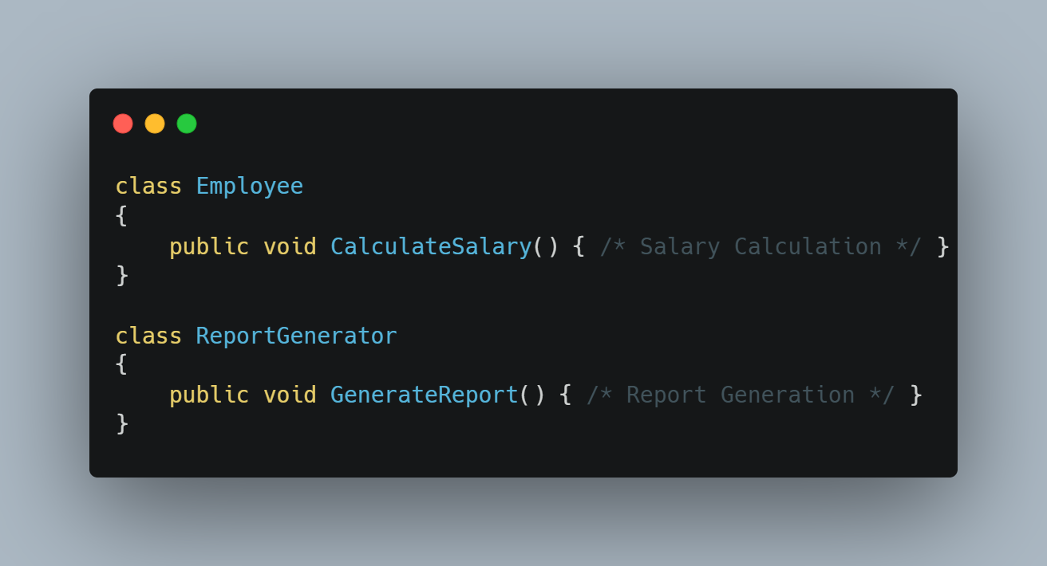
Single Responsibility Principle
Achieved
Employee handle salaries and ReportGenerator handles reports (Sepeartion of concerns).
www.bacancytechnology.com

Slide 12
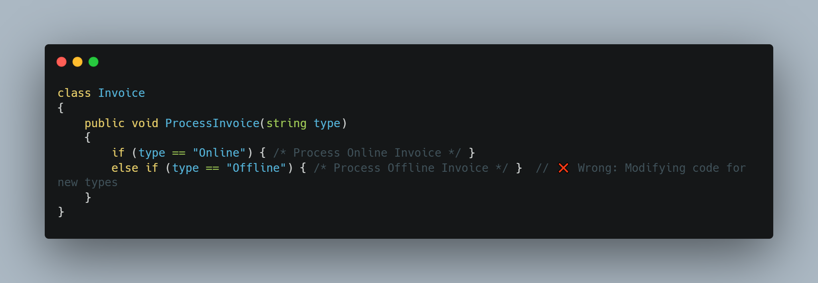
Open-Closed Principle
Achieved
Software entities (classes, modules, functions) should be open for extension but closed for modification.
Once a class is written, it should be closed for modifications but open for extensions.
Problem: Every time a new invoice type is added, we need to modify the class, which breaks OCP.
www.bacancytechnology.com

Slide 13
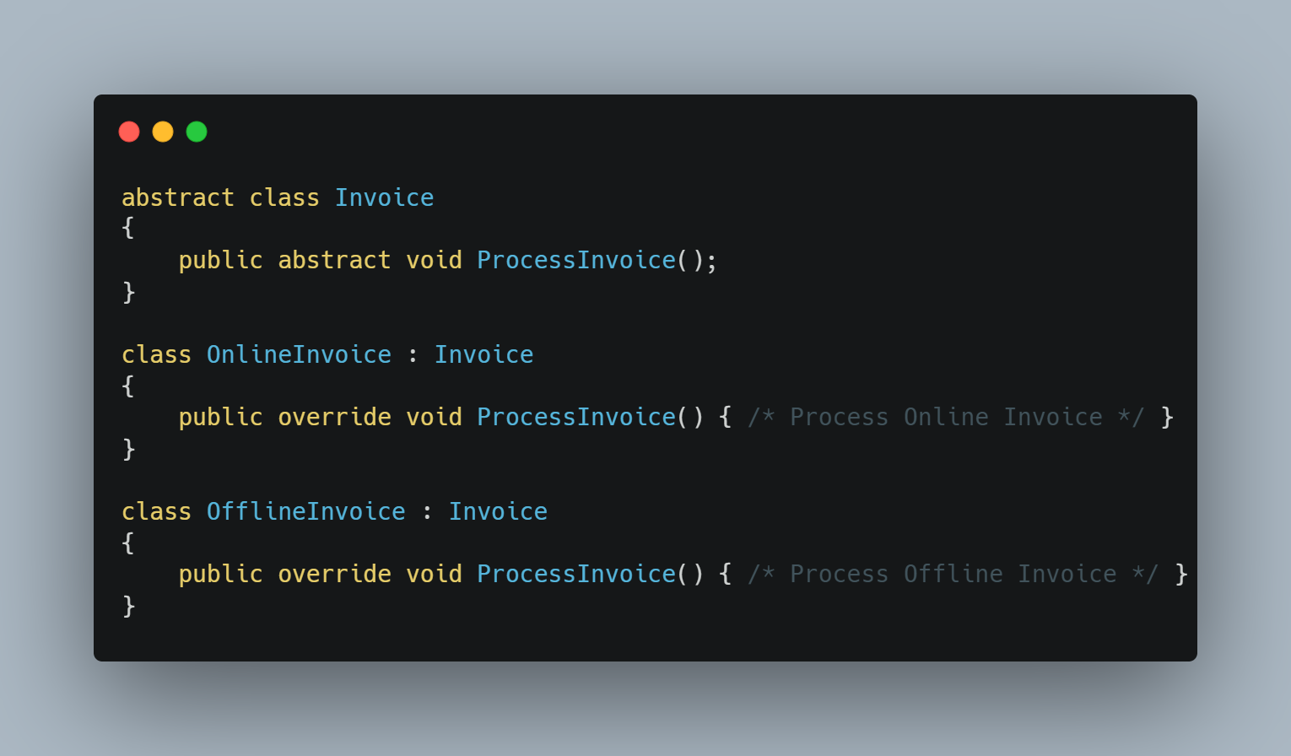
Open-Closed Principle
Achieved
New invoice types can be added without modifying existing code, only by extending the base class.
www.bacancytechnology.com

Slide 14
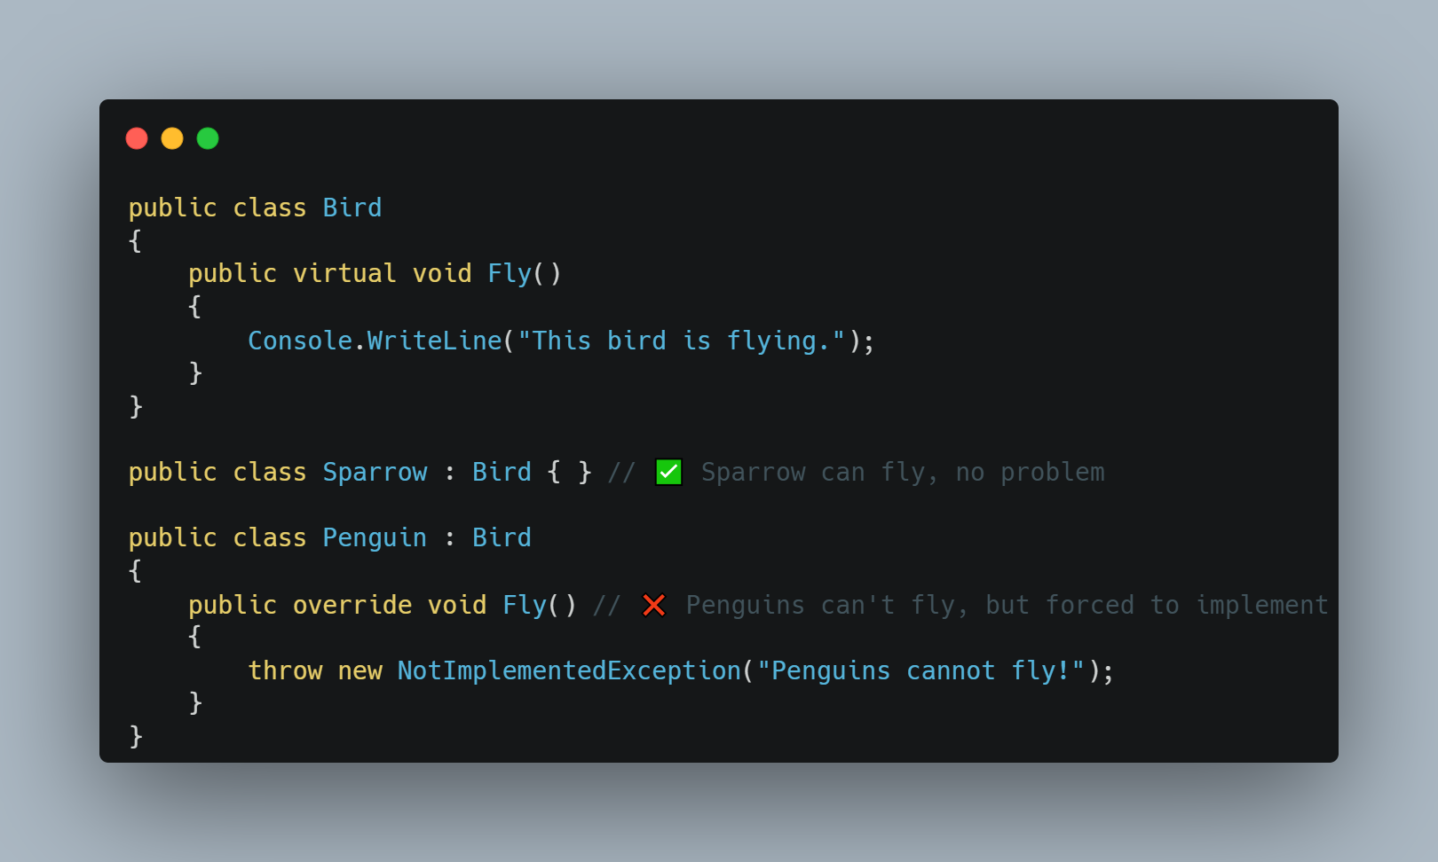
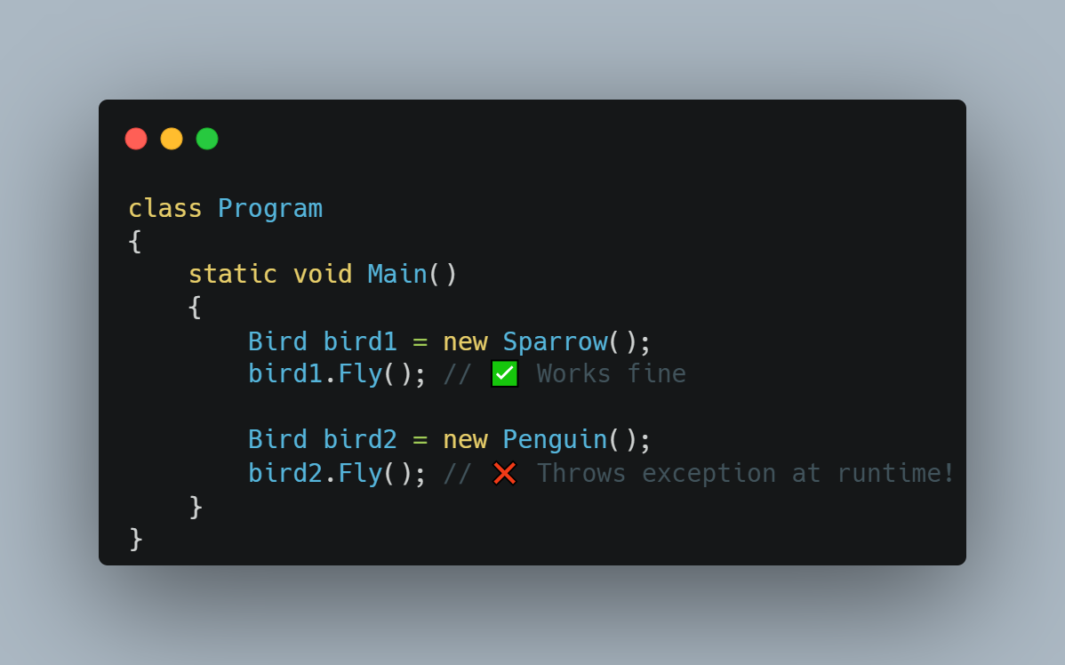
Liskov Substitution Principle
Achieved
Derived classes should be replaceable for their base classes without affecting correctness.
A subclass should be able to replace its superclass without causing errors.
www.bacancytechnology.com

Slide 15
Liskov Substitution Principle
Achieved
Problem :
Penguin inherits from Bird but cannot fly, so Fly() throws an exception.
This violates LSP because a Penguin cannot fully substitute a Bird without breaking behavior.
Solution :
Instead of forcing all birds to have a Fly() method, we should create separate interfaces for Flying Birds and Non-Flying Birds.
www.bacancytechnology.com

Slide 16
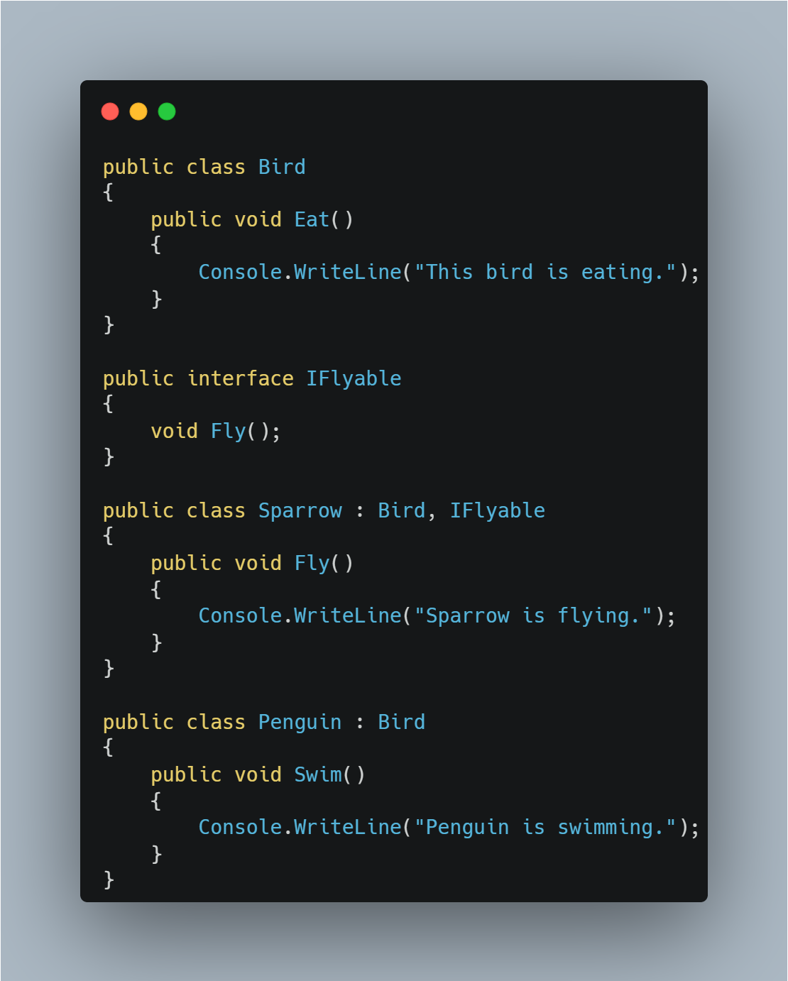
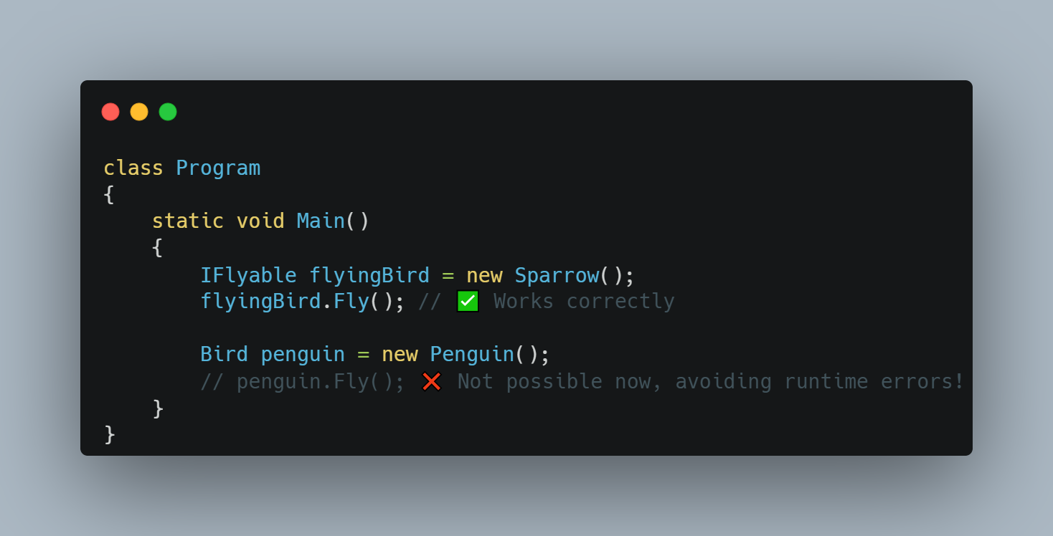
Liskov Substitution Principle
Achieved
www.bacancytechnology.com

Slide 17
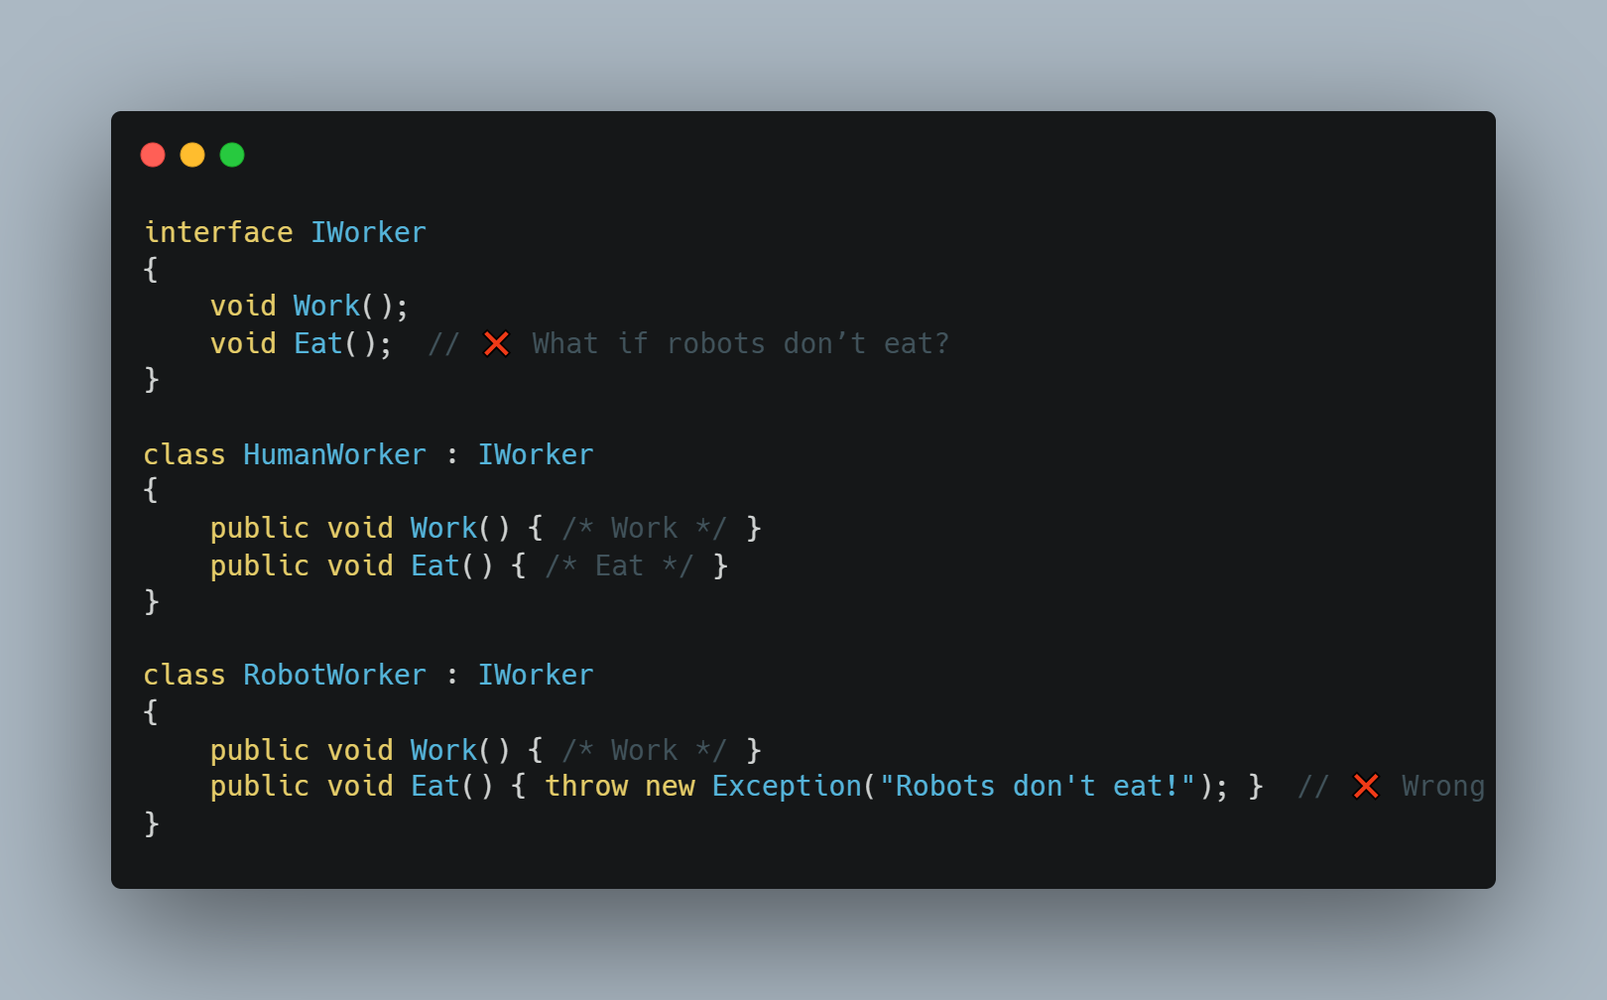
Interface Segregation Principle
Achieved
The Interface Segregation Principle states that a class should not be forced to implement interfaces it does not use.
This principle encourages the creation of small, client-specific interfaces.
www.bacancytechnology.com

Slide 18
Interface Segregation Principle
Achieved
Problem :
RobotWorker is forced to implement Eat(), which does not make sense for robots.
Solution:
HumanWorker implements both IWorkable and IEatable.
RobotWorker only implements IWorkable, avoiding the unnecessary Eat() method.
www.bacancytechnology.com

Slide 19
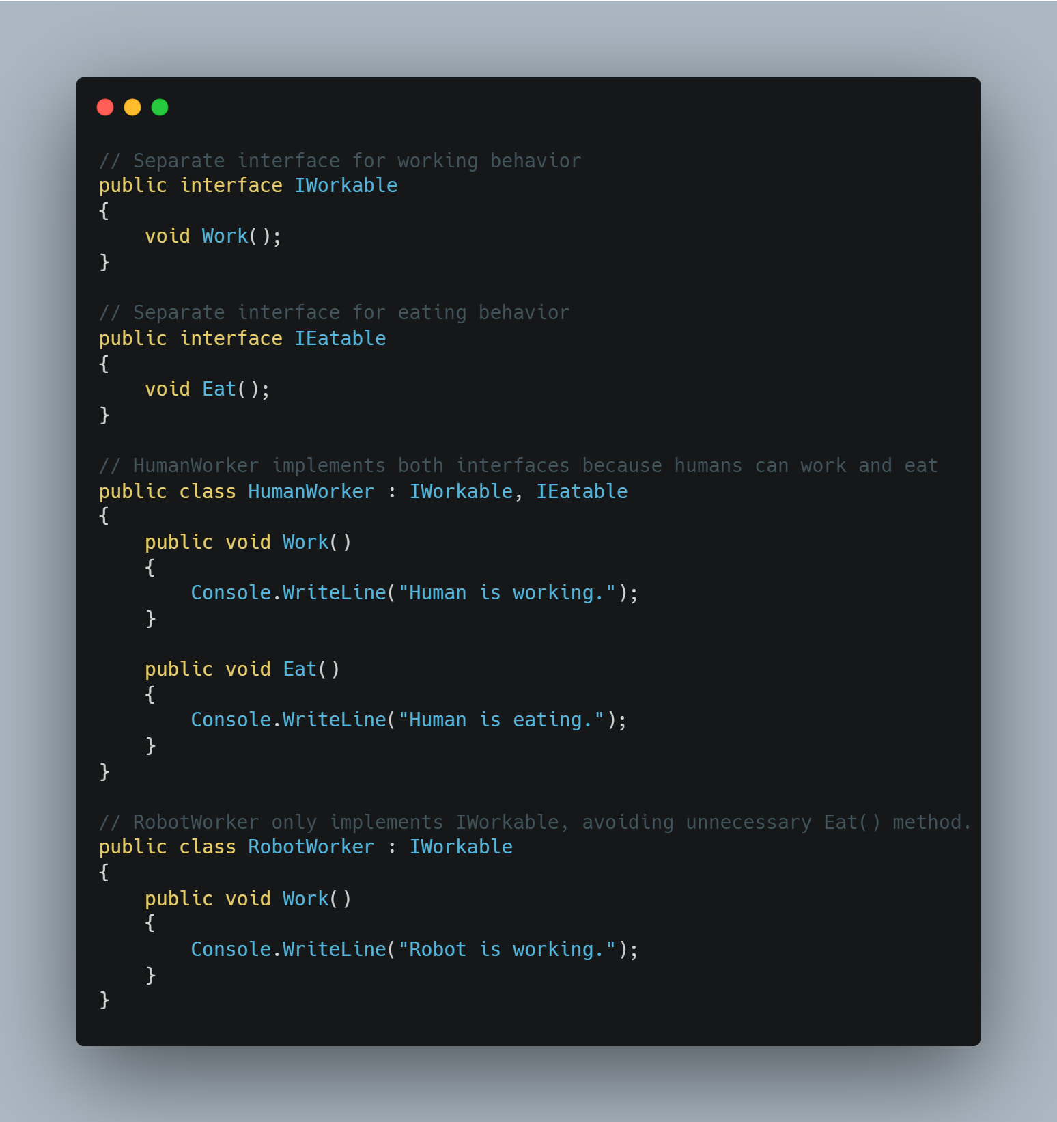
Interface Segregation Principle
Achieved
www.bacancytechnology.com

Slide 20
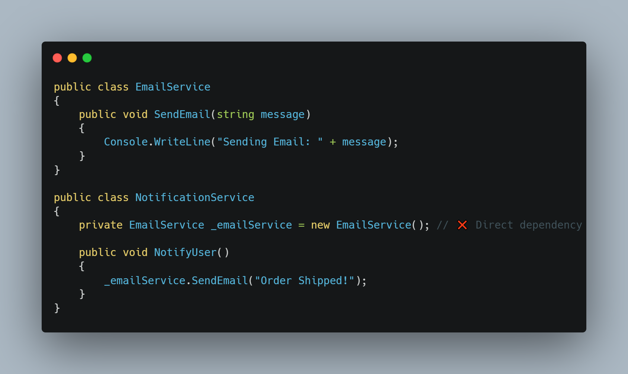
Dependency Inversion Principle
Achieved
Dependency Inversion Principle (DIP) states that High-level modules should not depend on low-level modules. Both should depend on abstractions.
Abstractions should not depend on details. Details should depend on abstractions.
www.bacancytechnology.com

Slide 21
Dependency Inversion Principle
Achieved
Problem:
NotificationService depends on EmailService directly.
If we want to switch to SMSService, we must modify NotificationService, violating Open/Closed Principle.
Solution:
Use Abstraction (Interfaces or Abstract Classes)
High-level modules should depend on this abstraction instead of concrete classes.
Apply Dependency Injection (DI)
Decouple High-Level and Low-Level Modules
www.bacancytechnology.com

Slide 22
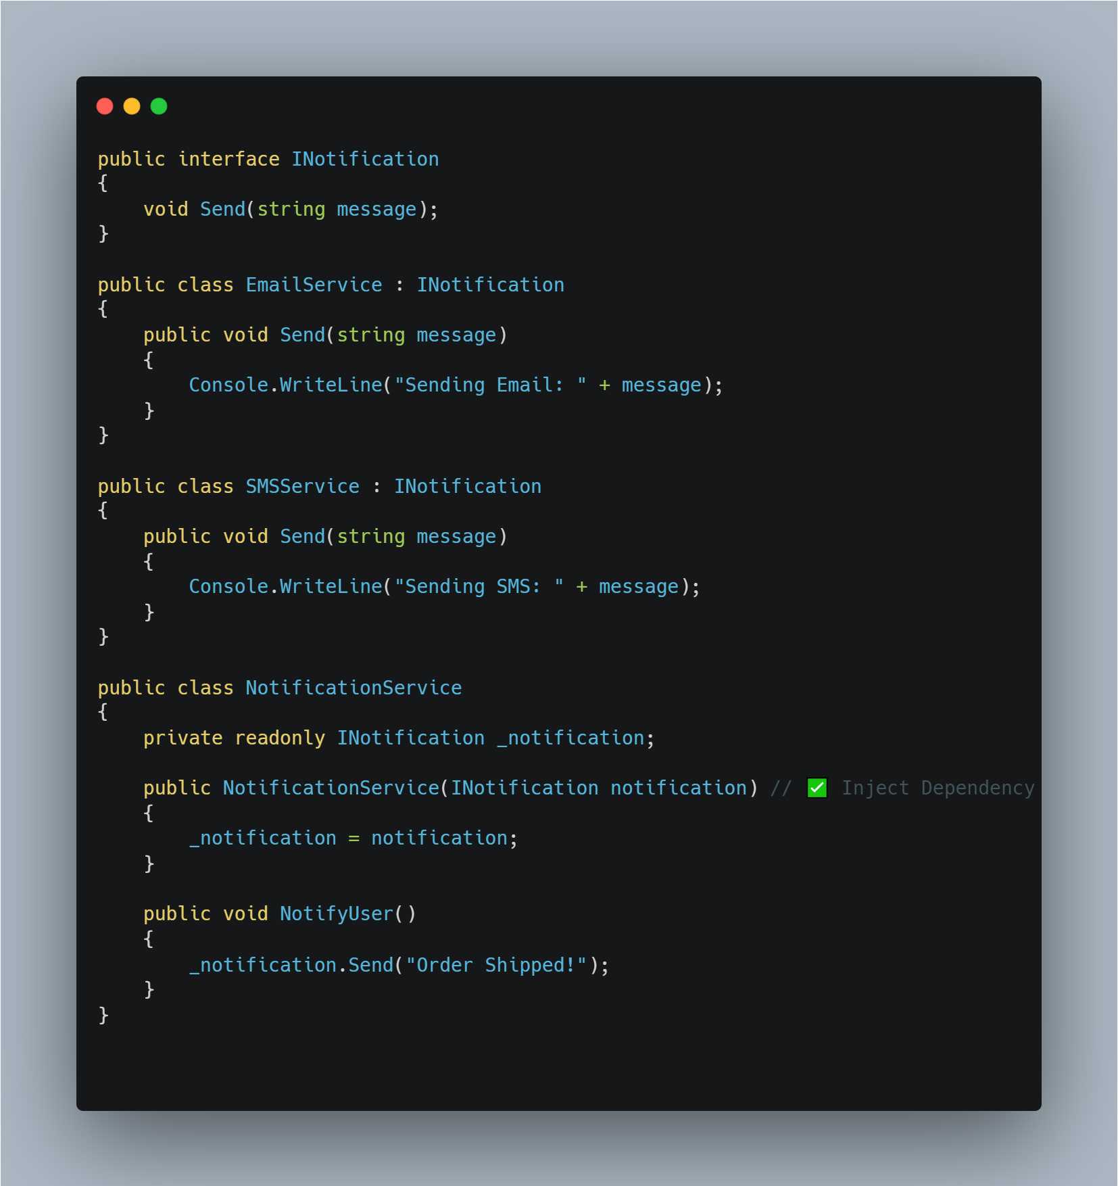
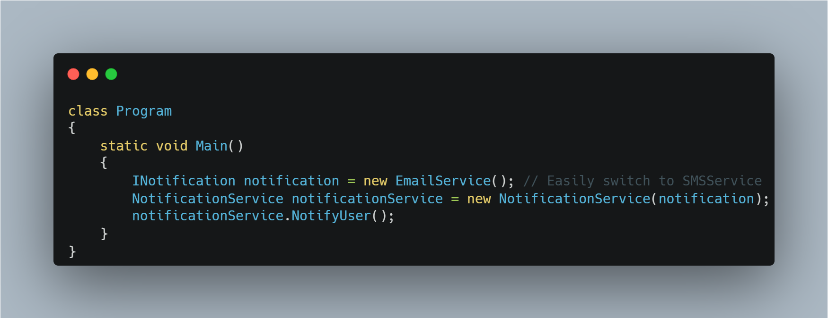
Dependency Inversion Principle
Achieved
www.bacancytechnology.com

Slide 23
Thank you

